Slide 1
AIRFRAME PROGRESS REPORT
WEEK 5
09/06/2023

Slide 2
OVERVIEW
Parachute testing
Fin attachment on the body tube
Polishing and painting of the airframe
Cutting and rolling of the aluminum sheet

Slide 3
PARACHUTE TESTING
1m and 2.4m diameter nylon parachutes were tested.
The 2.4m cloth parachute was also tested.
The height of the building used was 14.96m.

Slide 4
For the 1m parachute:
Mass (kg) | Experimented Terminal velocity (m/s) | Theoretical Terminal velocity (m/s)
1.556 | 5.24 | 6.33
0.999 | 5.965 | 5.07
3.421 | 9.6395 | 9.4

Slide 5
For the 2.4m parachutes:
Challenges encountered:
The height was not sufficient to get the expected results
The 2.4m diameter nylon parachute deployed when near the ground
mass(kg) | Experimented Terminal velocity (m/s) | Theoretical Terminal Velocity (m/s)
8.068 | 5.805 | 6.01

Slide 6

2.4m Diameter Cloth Parachute

Slide 7
1m Diameter Nylon Parachute

Slide 8
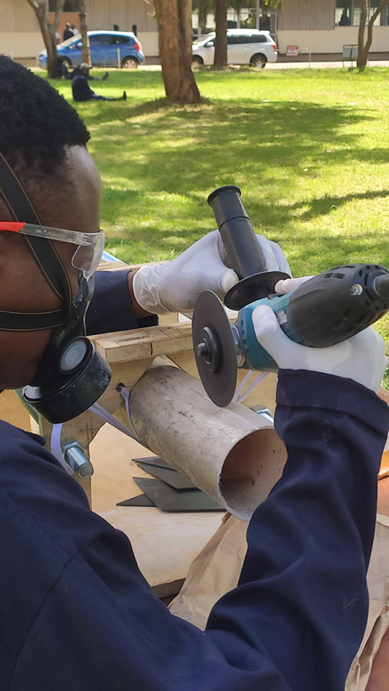
FIN ATTACHMENT ON THE BODY TUBE
Slits were cut to fit the fins on the airframe (safety measures were observed)

Slide 9
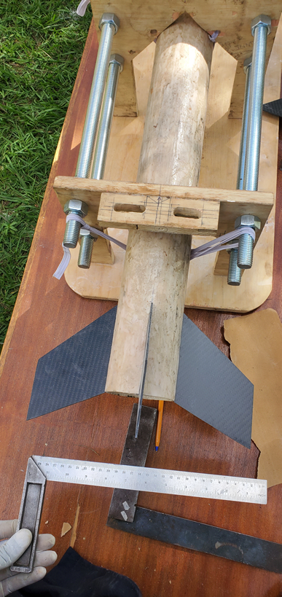
Body tube with fins attached

Slide 10
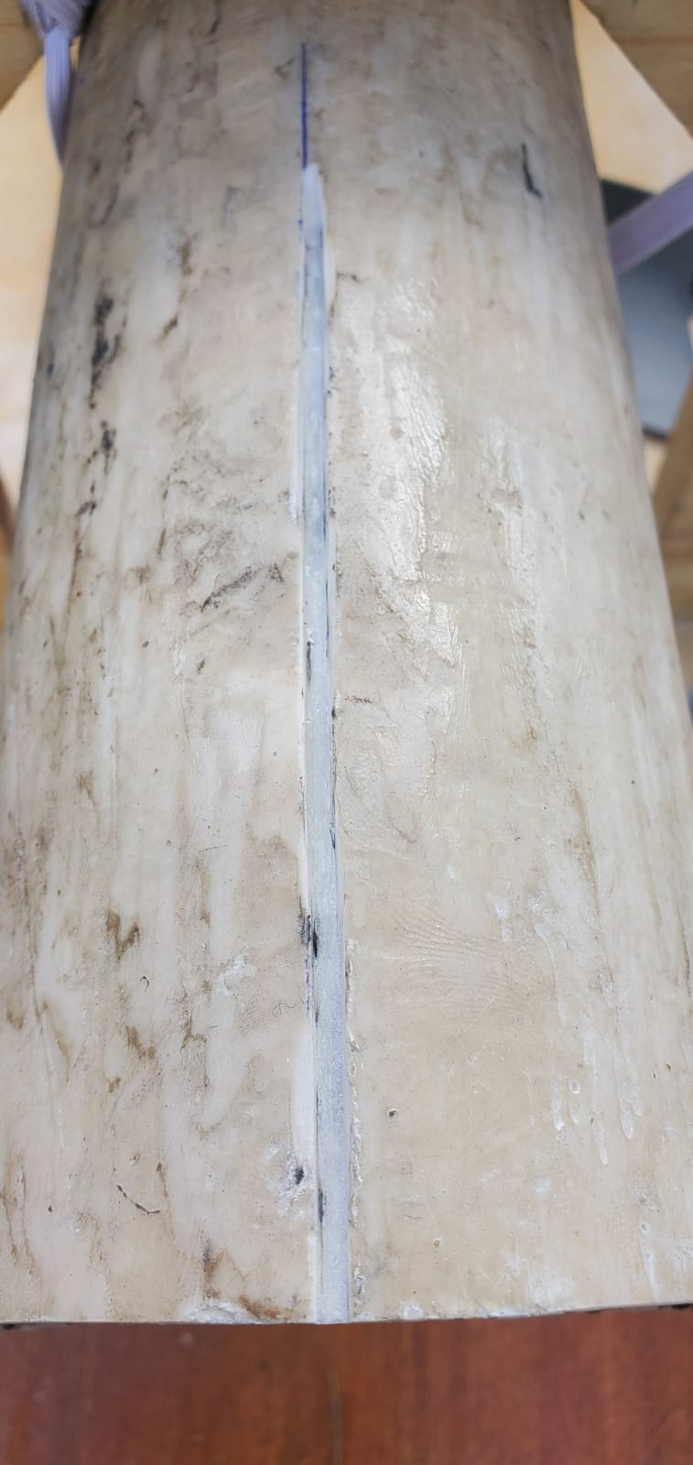
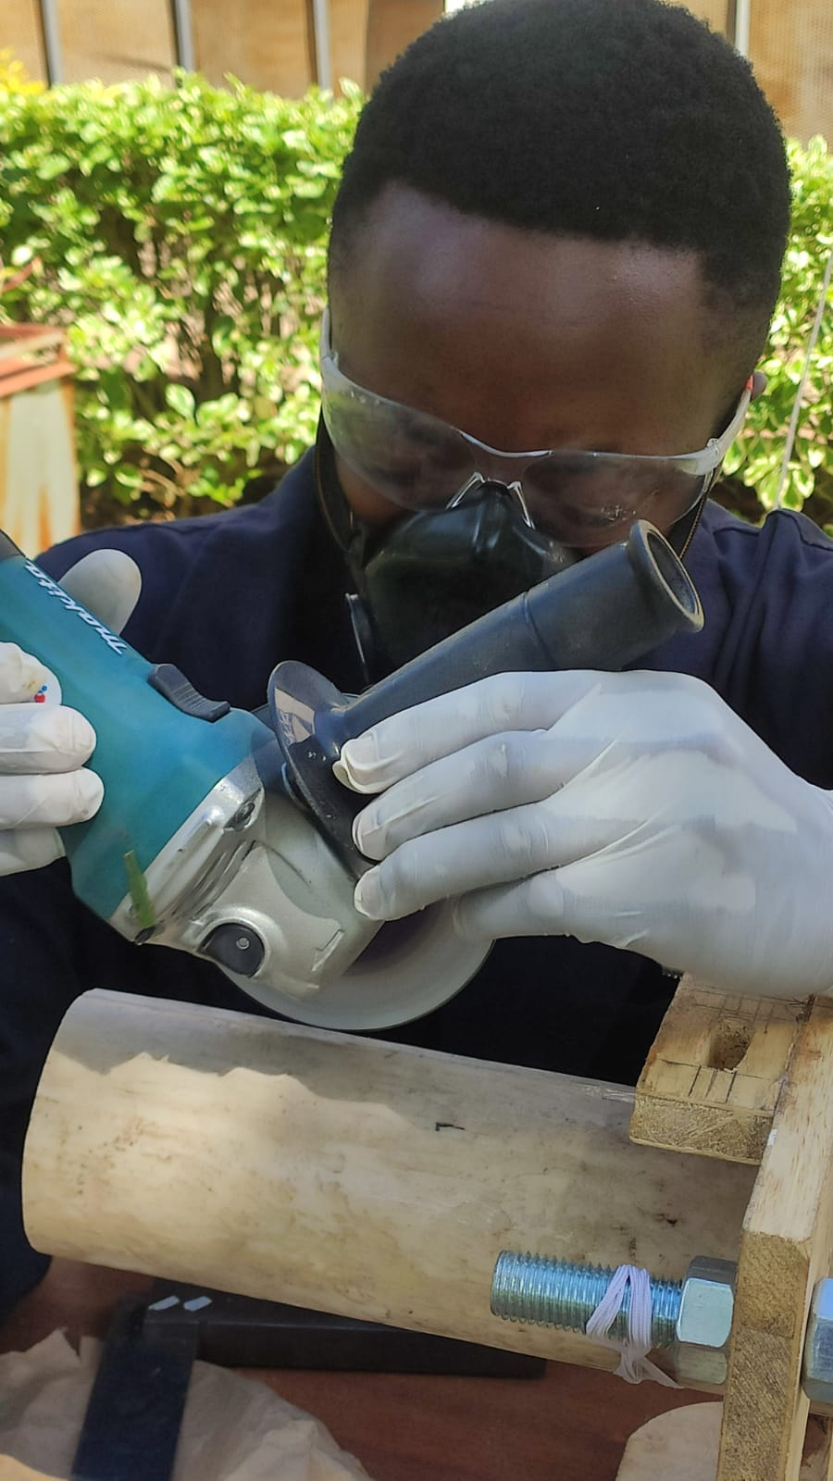
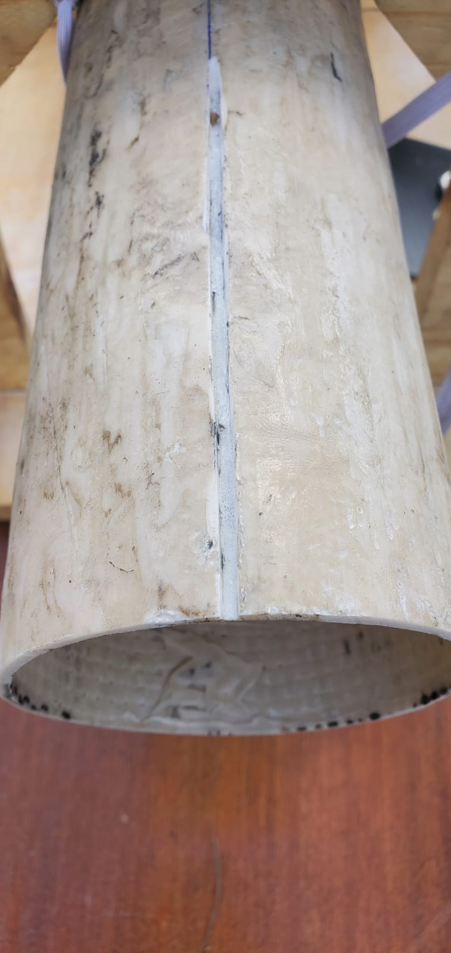
Cutting of grooves

Slide 11
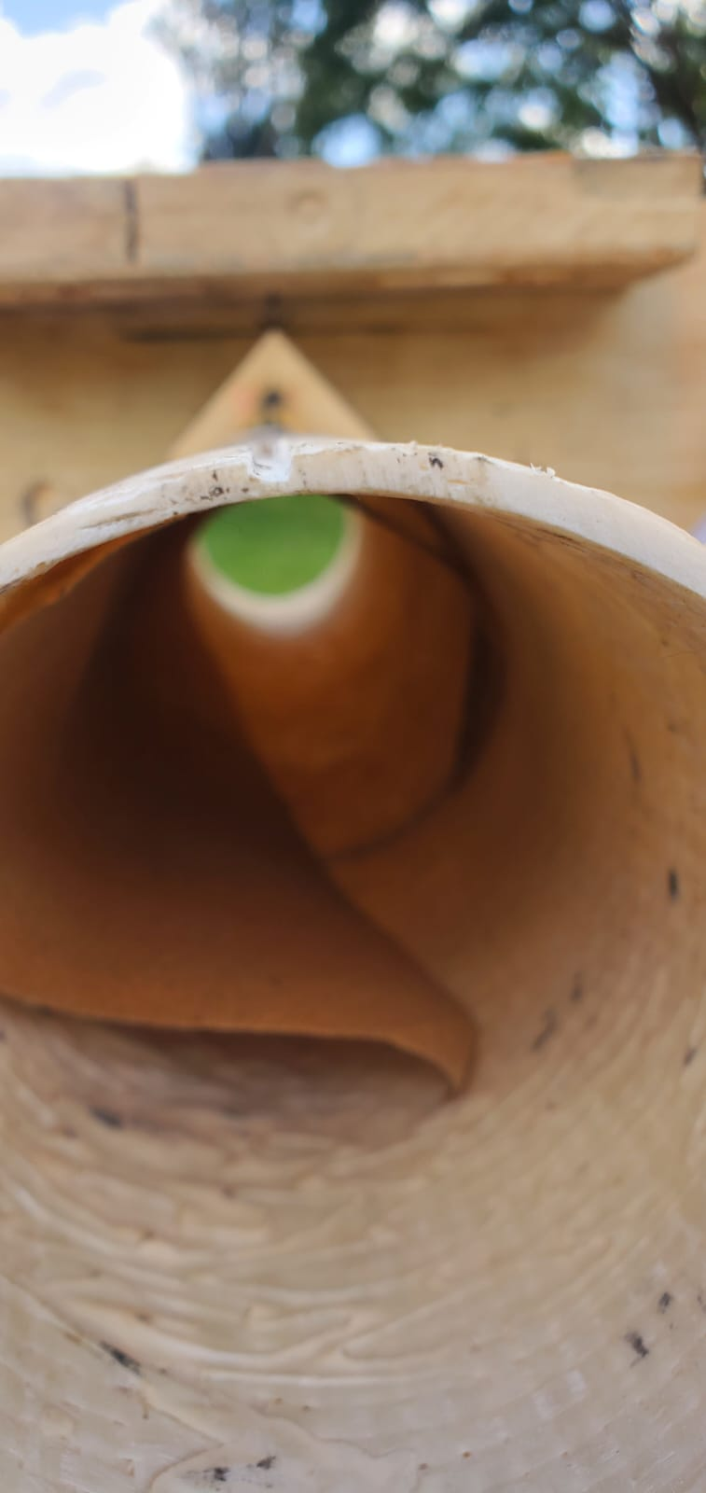
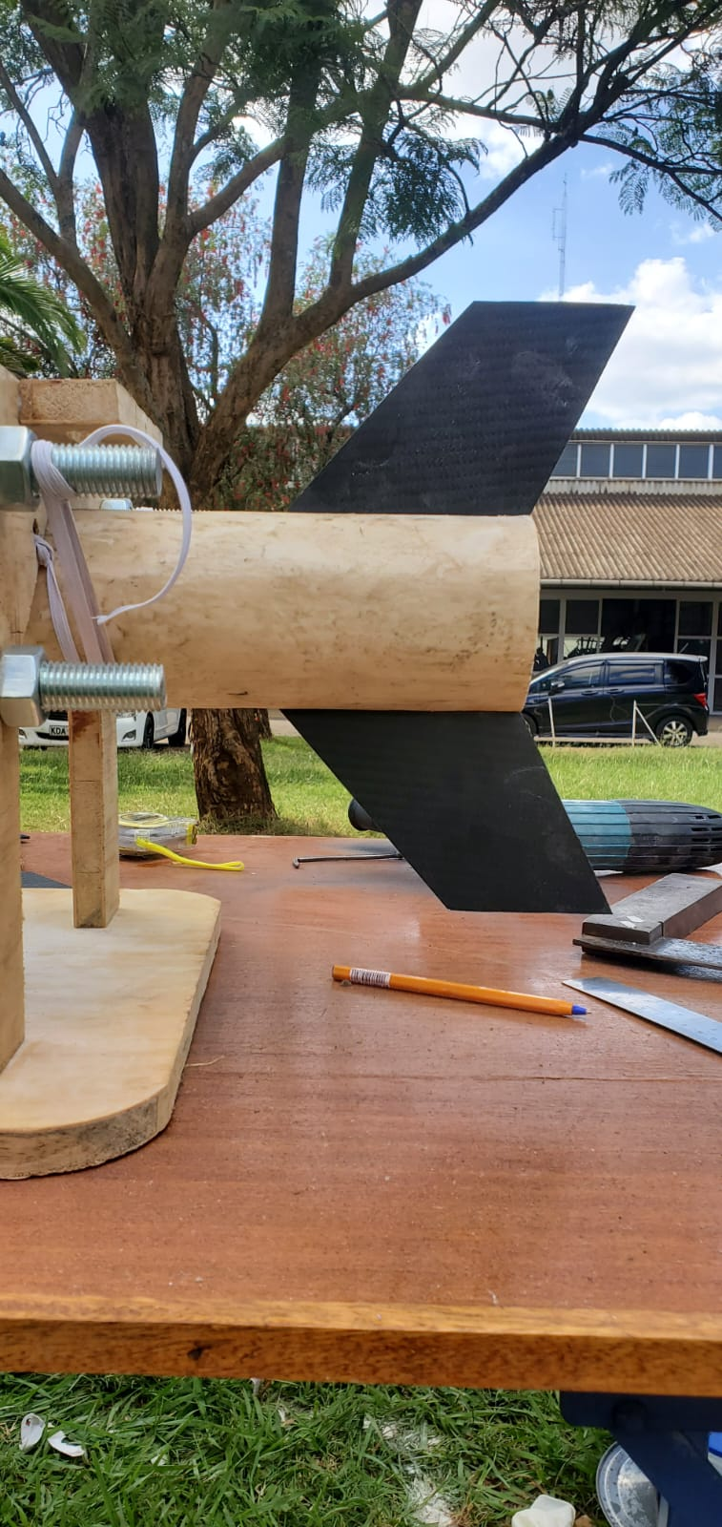
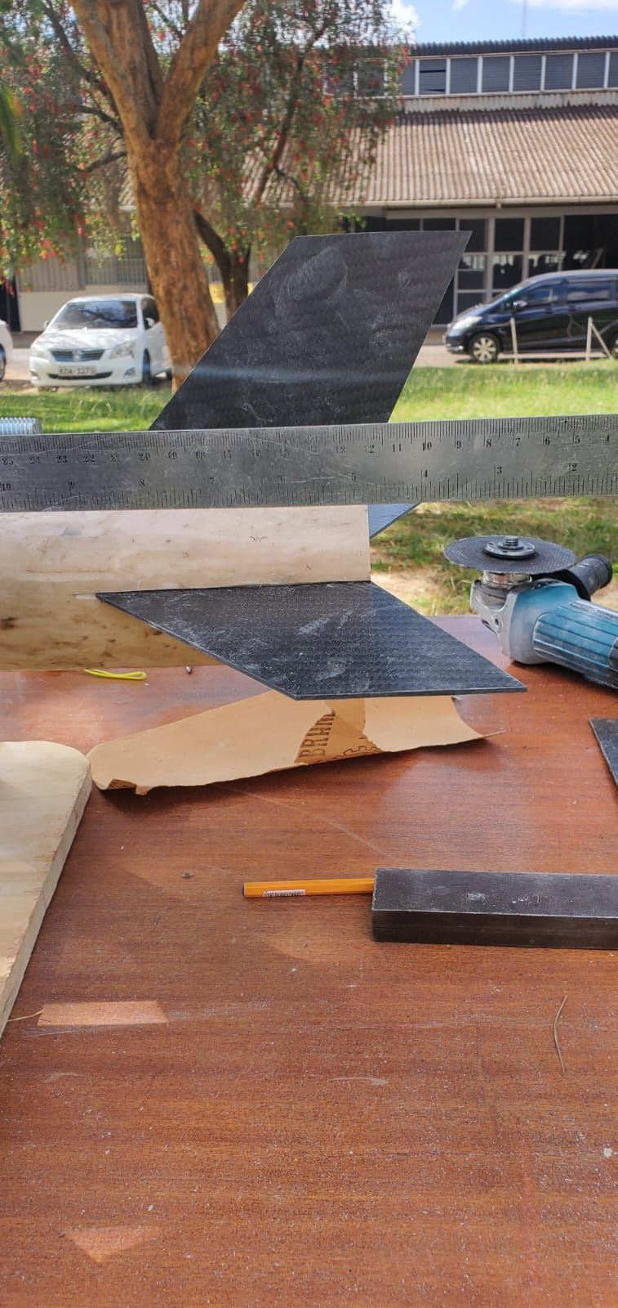

Slide 12
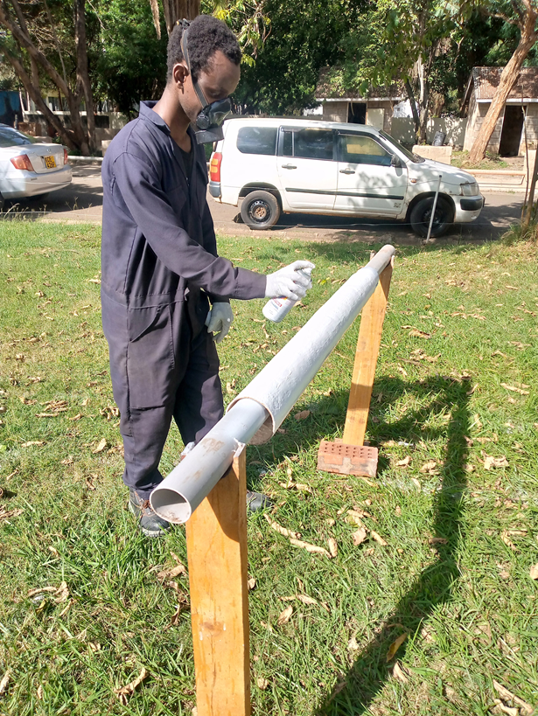
POLISHING AND PAINTING OF THE AIRFRAME
Safety measures were observed

Slide 13
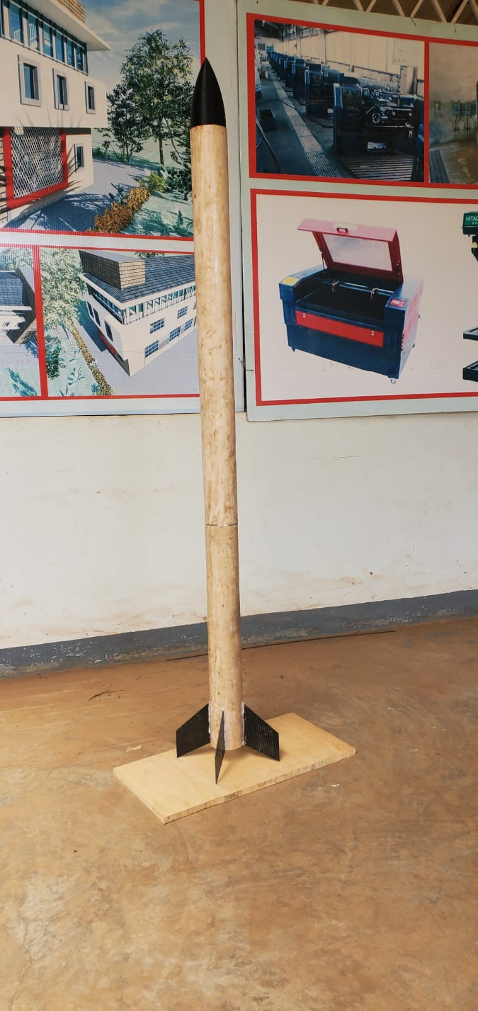
PHASE 1
Assembly of components
Polishing of the surface

Slide 14
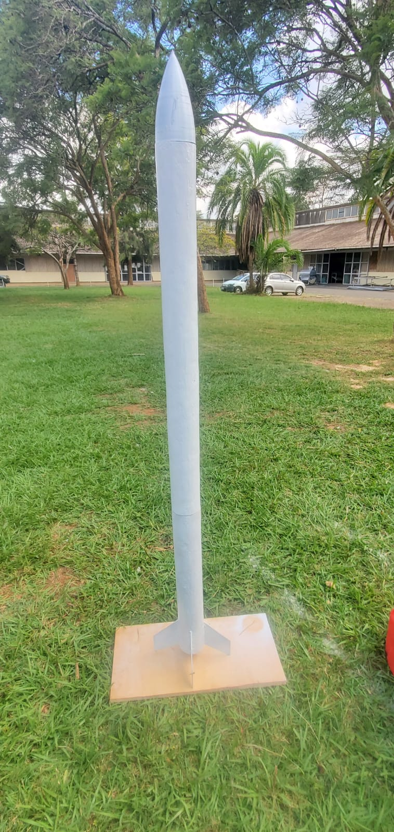
PHASE 2
Applying primer first layer coat

Slide 15
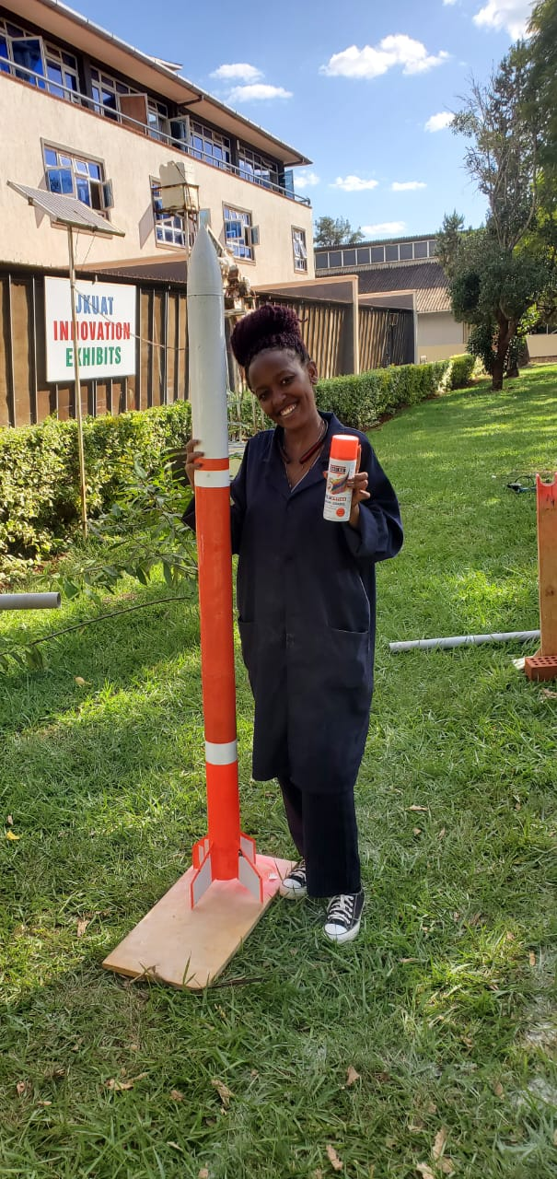
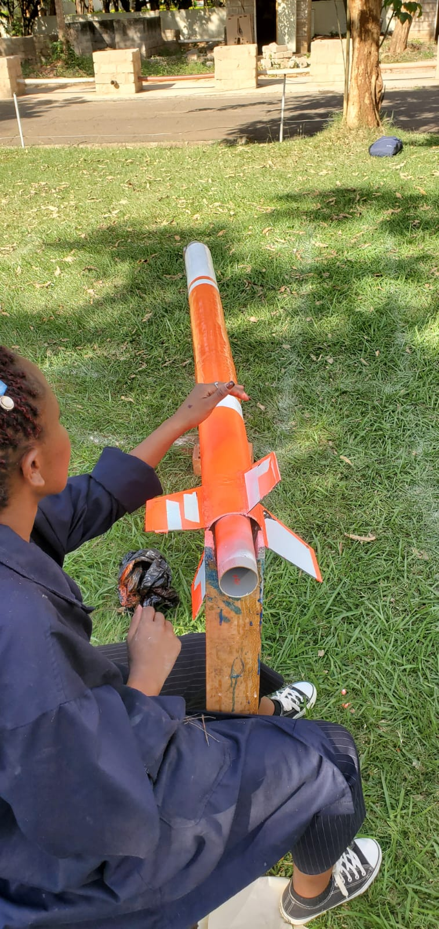
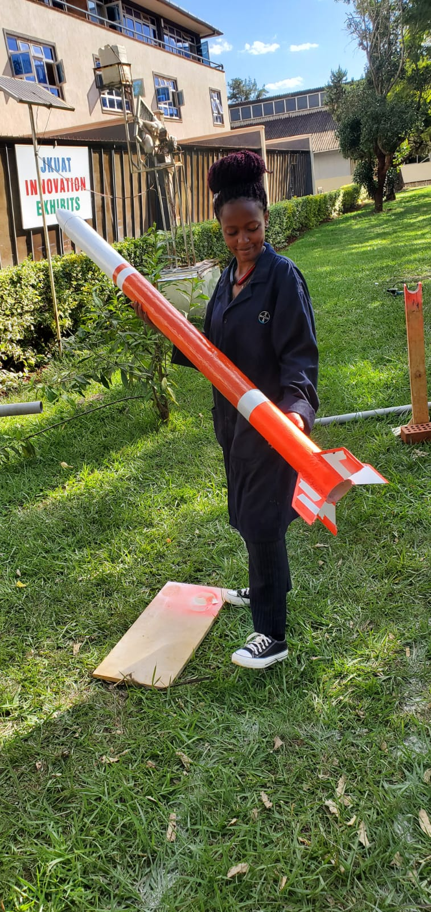
PHASE 3
Final paint

Slide 16
ROLLING OF THE ALUMINUM SHEET
A prototype was cut and rolled.
The rolled prototype was to be riveted but there no rivets.
For the remaining 3 airframe tubes the sheets were cut and only rolling and riveting remains.

Slide 17
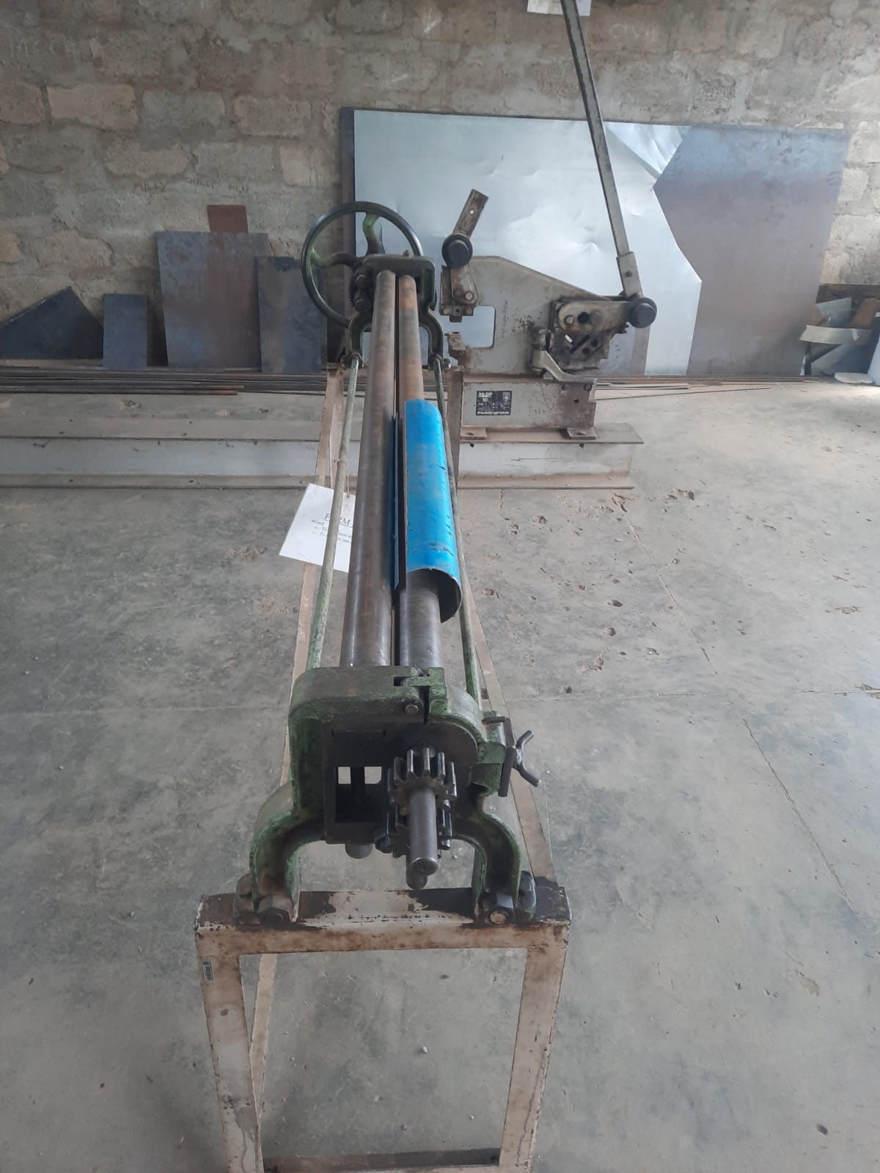
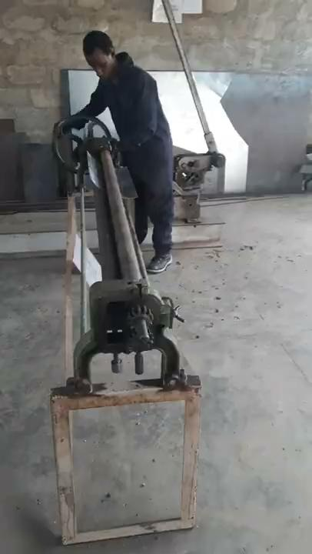
The rolling process of the aluminum sheet

Slide 18
ROCKET BEND TEST
The test was not done due to the following challenges:
The paint on the airframe had not dried .

Slide 19
CFD ANALYSIS
The planned session that was to take place on 06/06/2023 was postponed.

Slide 20
NEXT WEEK’S OBJECTIVES
To complete the rolling the aluminum sheets
Rocket Bend Test
Proceed with the parachute test

Slide 21
THANK YOU

